Slide 1

Report prepared on behalf of Team 6 by Adedolapo Ademiluyi Emmanuel Oladejo Daniel Adebayo
OFFICE SUPPLY ANALYSIS FOR DATALEUM

Slide 2
Table of Content
Overview
January and December Analysis 2014
2013 Q4 and 2014 Q4 Analysis
Key drivers of performance
Poor performing products
Tax Analysis
Recommendation/Conclusion

Slide 3
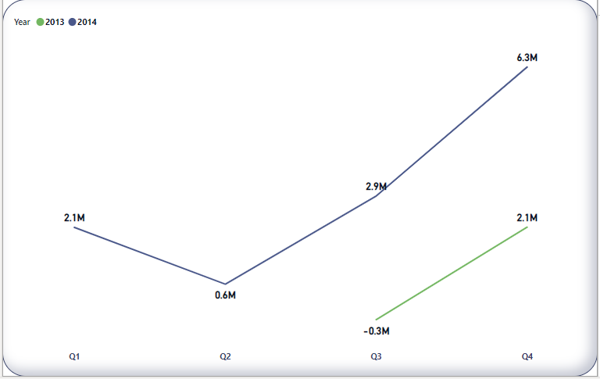
Overview on Profit
There is increase in profit in Q4 for both years
Qtr. 2 had the lowest profit for the year 2014 ﻿

Slide 4
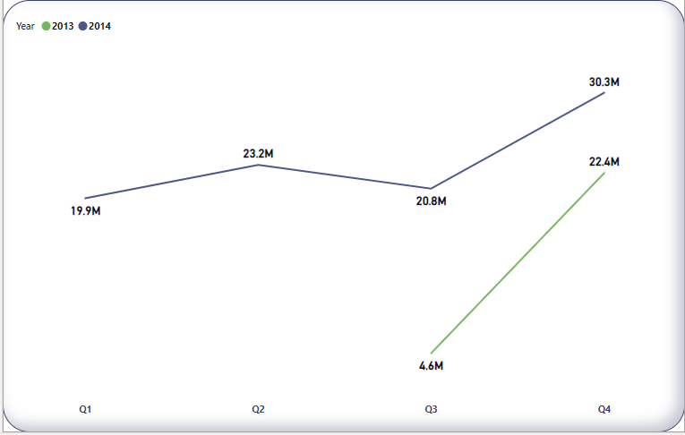
Overview on Revenue
There has been consistent increase in revenue from 2013 Q3 till 2014 Q2 then a dive in revenue in 2014 Q3. ﻿

Slide 5
Overview on Revenue
There has been consistent increase in revenue from 2013 Q3 till 2014 Q2 then a dive in revenue in 2014 Q3. ﻿

Slide 6
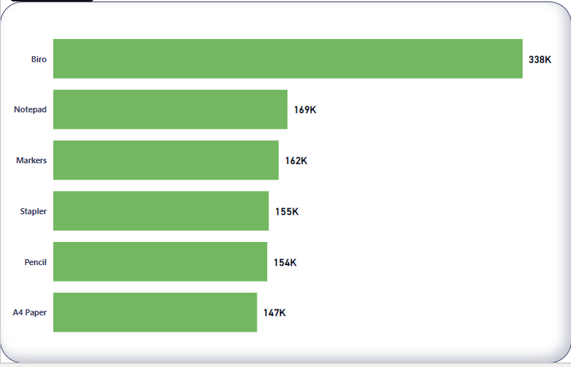
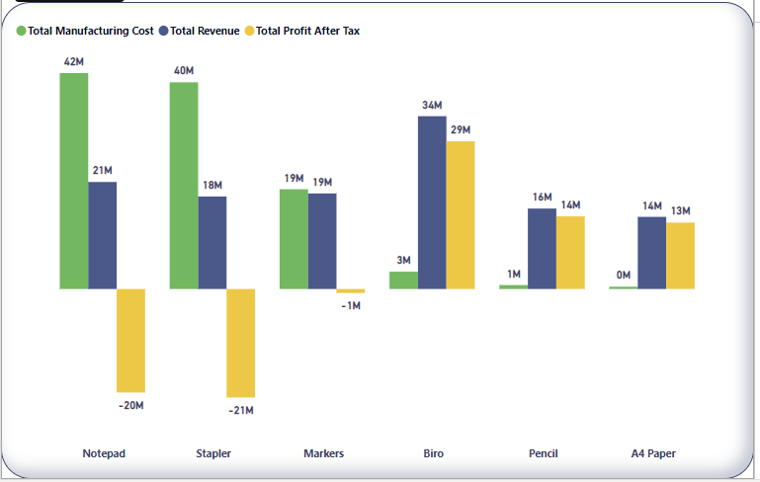
Overview for Product
Biro is the most sold product and also the product highest revenue and profit after tax.

Slide 7
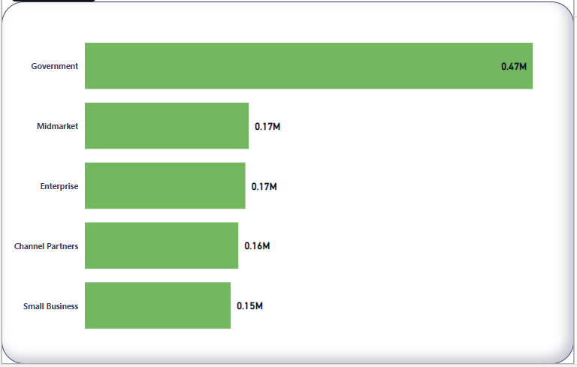
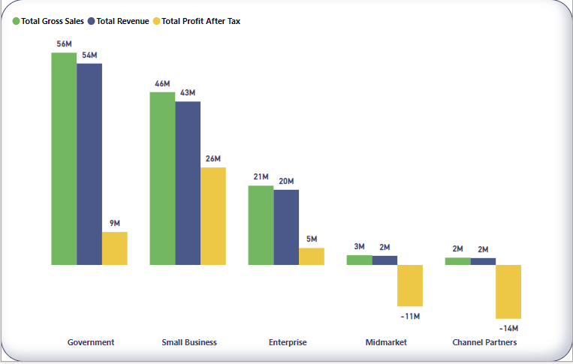
Overview for Segment
Government had the highest Revenue and Gross Sales.
Small business had the highest PAT.
Channel Partners and Midmarket suffered losses.

Slide 8
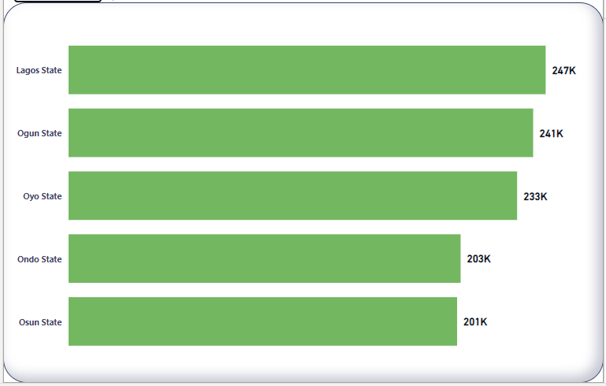
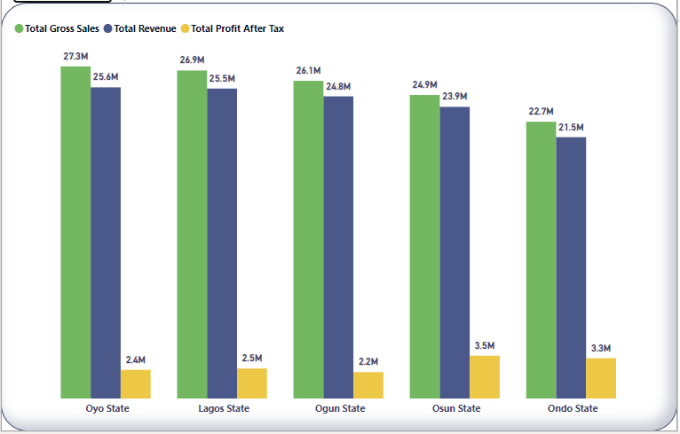
Overview for State
Oyo state had the highest gross sales and revenue.
Osun state had the highest PAT.

Slide 9
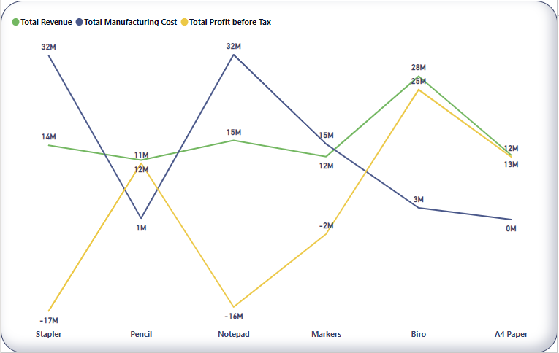
Product Analysis between Jan and Dec 2014
Stapler and Notepads both suffered huge losses (17M and 16M) respectively.

Slide 10
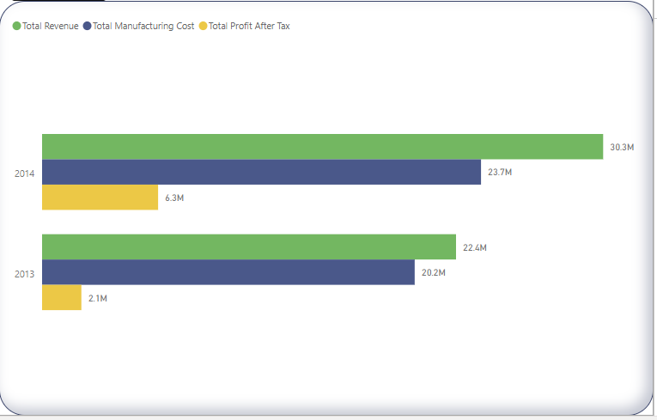
2013 Q4 and 2014 Q4 ANALYSIS
2013 Q4 and 2014 Q4 both recorded consistent profit.

Slide 11
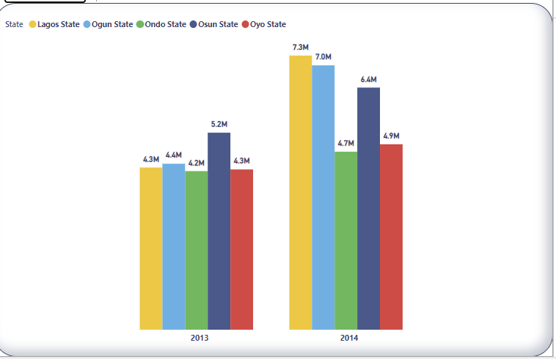
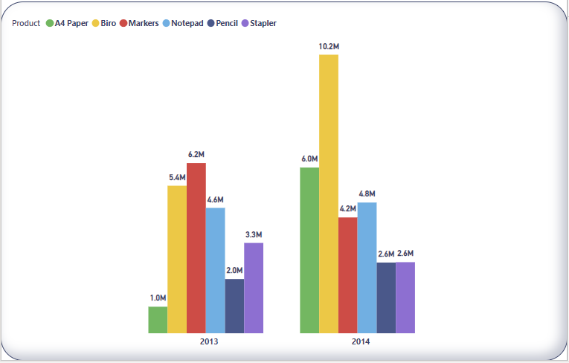
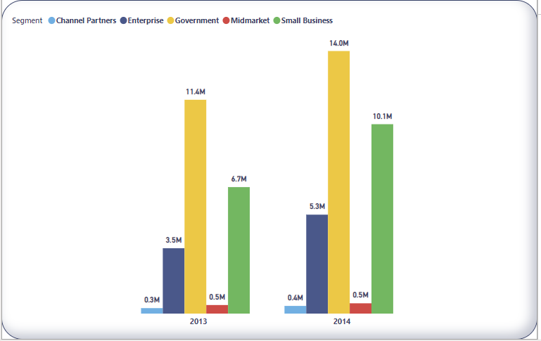
2013 Q4 and 2014 Q4 ANALYSIS BY REVENUE
Government had the Revenue in both 2013 and 2014 Q4.
Osun State also had the highest revenue in both 2013 and 2014 Q4.
Biro also had the highest turnover in both 2013 and 2014 Q4.

Slide 12
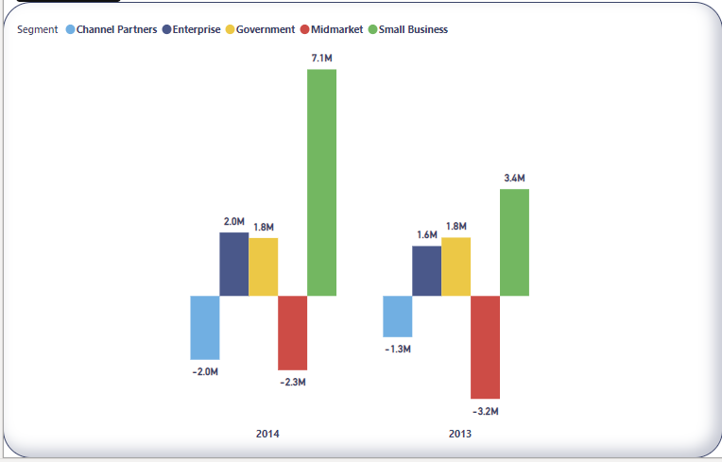
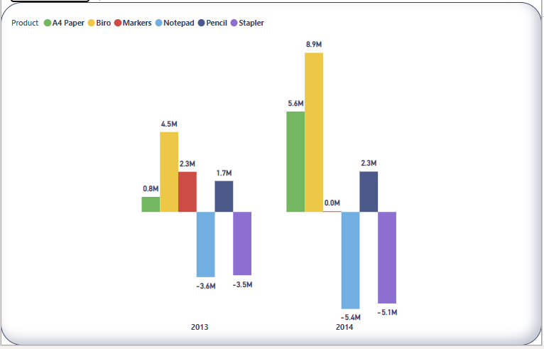
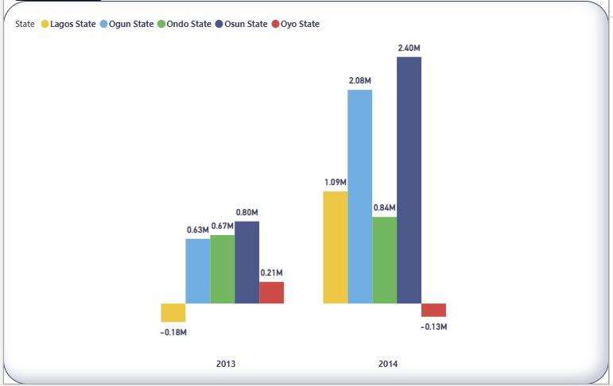
2013 Q4 and 2014 Q4 ANALYSIS BY PROFIT AFTER TAX
Small business had the highest Profit after Tax in both 2013 and 2014 Q4.
Osun State also had the highest Profit After Tax in both 2013 and 2014 Q4.
Biro also had the highest turnover in both 2013 and 2014 Q4.

Slide 13
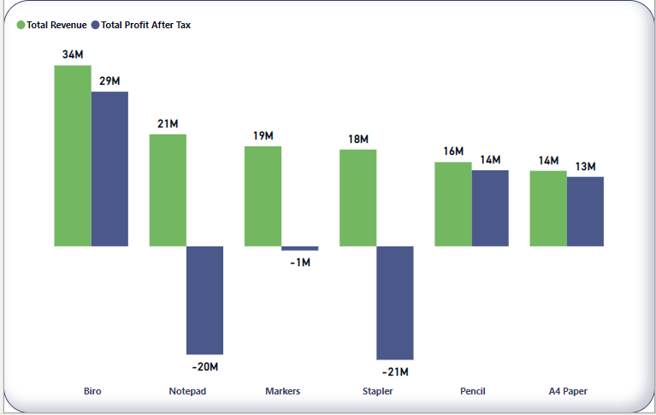
KEY DRIVERS OF PERFORMANCE
The below Products that generated high Revenue and high Profit after Tax are the key drivers.
Biro
Pencil
A4 Paper.

Slide 14
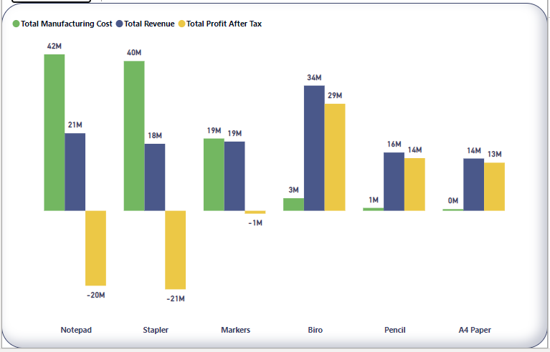
POOR PERFORMING PRODUCTS
Stapler followed by Notepad followed by markers all suffered loses

Slide 15
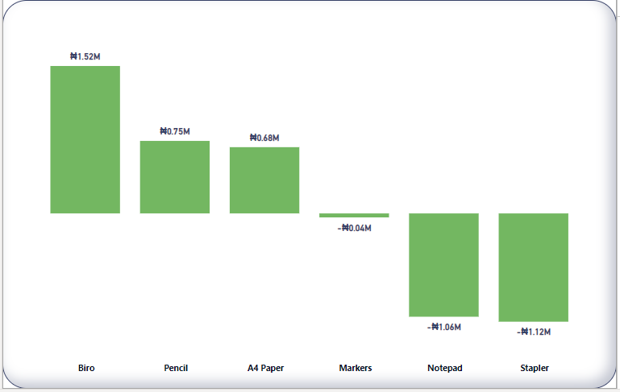
TAX ANALYSIS BY PRODUCT
The highest tax of ₦1.52M is paid on Biro followed by ₦0.75M paid on Pencil.

Slide 16
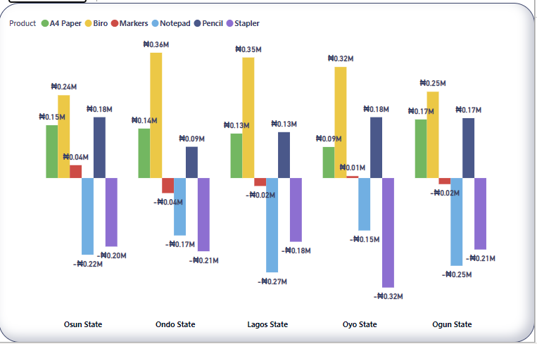
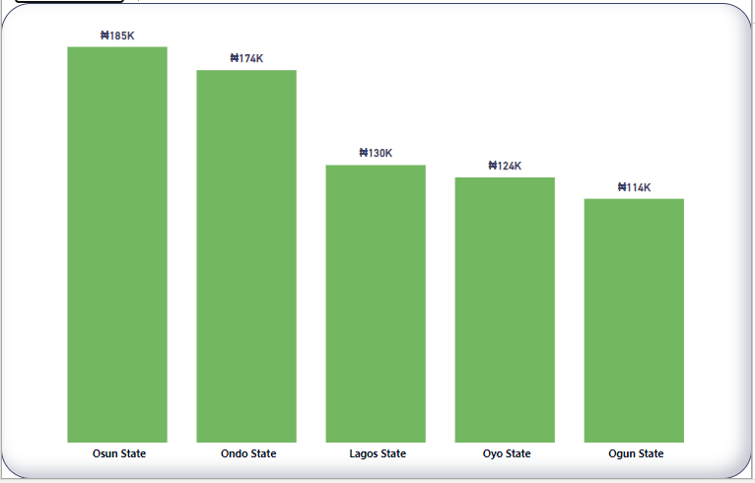
TAX ANALYSIS ON PRODUCT BY STATE
Osun State pays the highest tax.
Ondo and Lagos State pays the highest tax on Biro while Ogun and Lagos pays the least tax on Markers respeectively

Slide 17
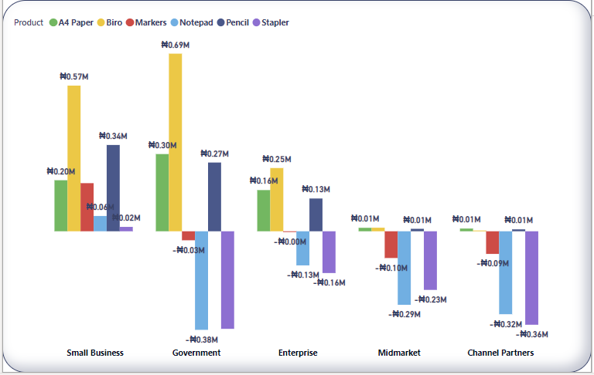
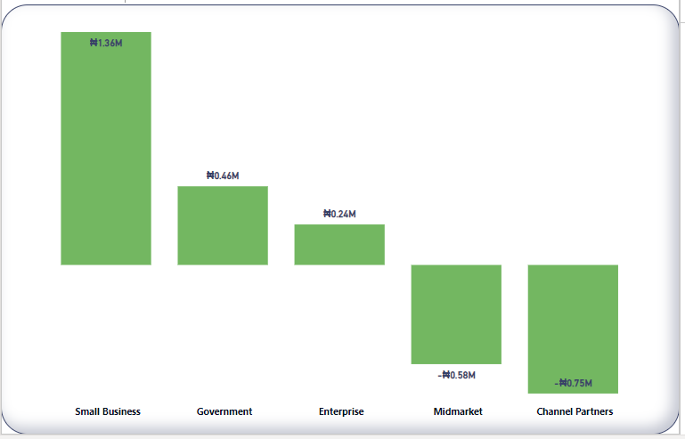
TAX ANALYSIS ON PRODUCT BY SEGMENT
Small business pays the highest tax.
Small business and Government pays the highest tax on Biro while Ogun and Lagos pays the least tax on Markers respectively

Slide 18
RECOMMENDATIONS/CONCLUSION
From the data given, the best approach to increase revenue and profit is to reevaluate each product.
An Increase in the manufacturing cost on A4 paper and pencil next year could have a better impact on both revenue, PAT .
More focus on 2014 should be on Biro, A4 Paper and pencil
Notepad and Stapler should be discontinued as the both suffered from about 50% loss respectively.
Markers should be placed under review.

